Slide 1
Microscopy
Resolution = Resolving Power
-the smallest distance (d) at which two objects can be successfully distinguished.
Resolution (d): d = (0.61 x λ)/ NA
    λ= wave length n = refractive index of medium
    NA= numerical aperture α = ½ of angular aperture
NA= n sin α

Slide 2
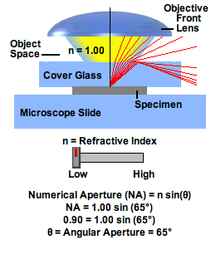
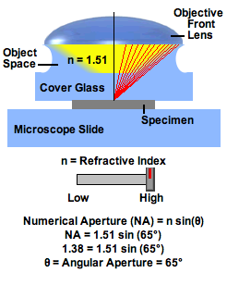
NA= n sin α
Refractive index (η) of different media
Air=1.0003 Water=1.33 Immersion Oil=1.515

Slide 3
Resolution versus Wavelength
Resolution: d= 0.61 x λ
NA
Wavelength (nanometers) Resolution (micrometers)
360 .19
400 .21
450 .24
500 .26
550 .29
600 .32
650 .34
700 .37

Slide 4
Resolving Distance (d)
Human eye 0.2 mm
Light Microscope 0.2 um
Scanning Electron Microscope 2.5 nm
Transmission Electron Microscope 1.0 nm
Resolution: d= (0.61 x λ)/ NA
HistoTip: Avoid confusion when discussing resolution. Increased resolution or resolving power usually means a SMALLER value of d (distance).

Slide 5
PROBLEM:
Objective lens A:
Magnification = 40X
N.A. = 0.45
Objective lens B:
Magnification = 40X
N.A. = 0.80
-->Which objective lens would give the sharper image and why?

